Slide 1

Credit Risk AnALYSIS
Case Study
on
Case Study on Credit Risk Analysis

Slide 2
Objective
To find the patterns present in the loan data by the help of EDA.

Slide 3
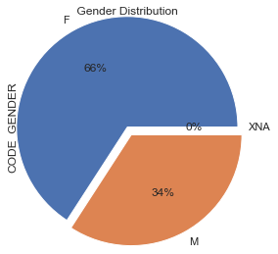
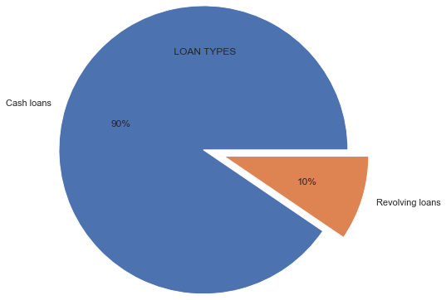
c
Dataset consist of more than 3 lakh people
Female has taken more loan than the male population
90 percent loans are given as cash loan wherein the revolving loans are only 10 percent.

Slide 4
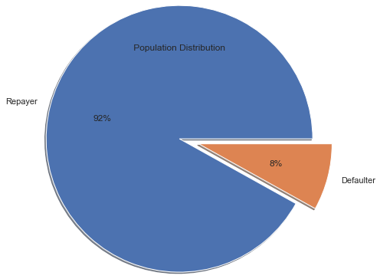
Out of 3 lakhs person , Repayer percentage is 92 percent which is beneficiary to the company but default percentage is around 8 percent which is the loss to the company.

Slide 5
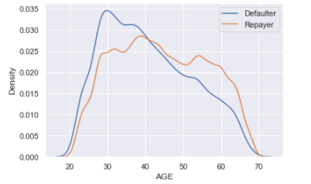
Applicants with age category of 20-40 are most likely to be defaulters than the other age groups.

Slide 6
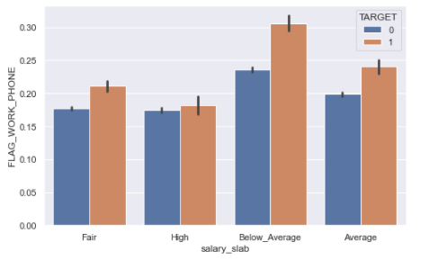
c
Applicant with BELOW AVERAGE salary and who have provide home phone are having higher chance to be a defaulter than the other salary group

Slide 7
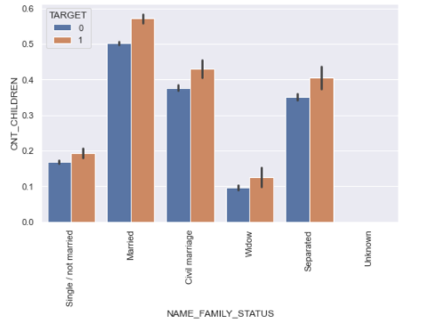
Married applicant who have more then 4 children, have high chances to be a defaulter.

Slide 8
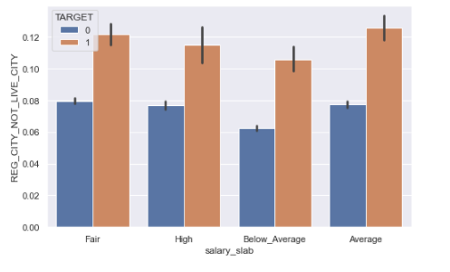
c
Average salary applicant whose contact address(CITY-LEVEL) does not match, has higher chance to be defaulter.

Slide 9
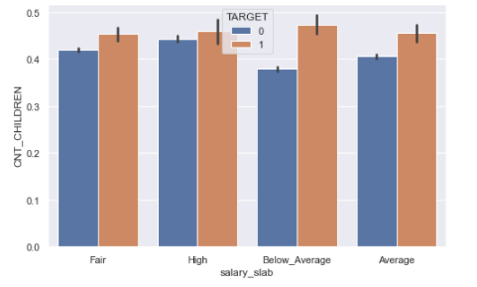
c
Applicant with below average salary with more then 4 children is likely to be defaulter.

Slide 10
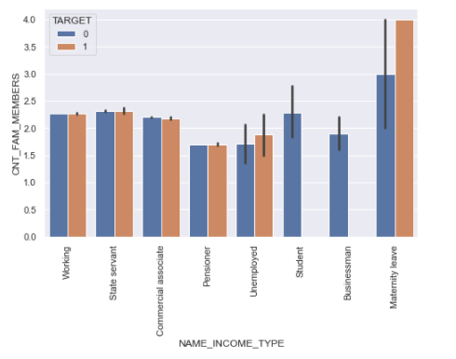
People with Below average salary with more then 4 children is likly to be more defaulter.
c
People who are on Maternity Leave tends to be defaulter when they have more Family Members.

Slide 11
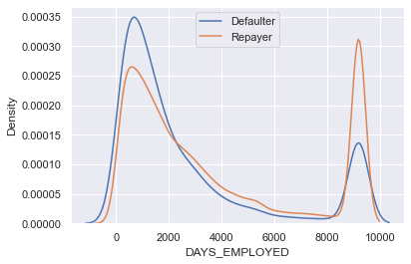
c
A person’s employability plays an important role , as we look at the chart it clearly shows person whose working days are less than 2000 are likely to do the default whereas a person who worked between 8000 -10000 days are beneficiary for the bank.

Slide 12
c
Client with BELOW AVERAGE salary and who have provide home phone are having higher chance to be a defaulter.

Slide 13
c
Client with BELOW AVERAGE salary and who have provide home phone are having higher chance to be a defaulter.

Slide 14

Thank you
Abhimanyu Sharma
( Just.abhi08@gmail.com )
Himanshu Chauhan
( himanshuchauhan318@gmail.com )

Slide 15
Submission by:- Himanshu Chauhan (himanshuchauhan318@gmail.com ) ABHIMANYU Sharma (Just.abhi08@gmail.com )
EDA CASE STUDY

